Slide 1

Laravel Pemula – Lanjutan

Slide 2

Laravel 01 Bina Projek Laravel Pemula

Slide 3
Module Outcome
Day 1
Create Laravel Project
Working with Database.
Working with Model
Working with Controllers
Working with Views
What will be needed
Laragon
phpMyAdmin
VS Code

Slide 4
routes/web.php
app/Http/Controllers
app/
resources/views
Notes:
In Slide Show mode, select the arrows to visit links.

Slide 5
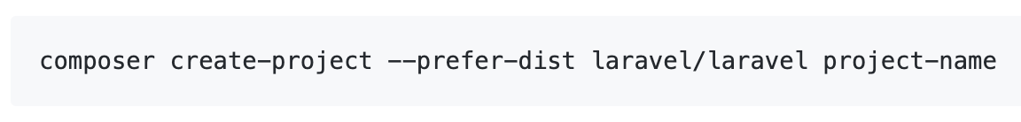
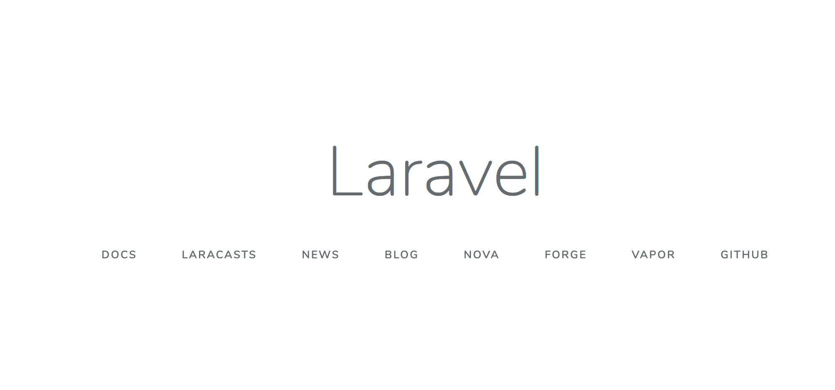
Create Laravel First Project
Install Laravel by issuing the Composer create-project command in your terminal

Slide 6
laragon.org
With Laragon?
Never been EASIER.

Slide 7
Laragon
What is Laragon? Laragon is a portable, isolated, fast & powerful universal development environment for PHP, Node.js, Python, Java, Go, Ruby. It is fast, lightweight, easy-to-use and easy-to-extend. Why Laragon? Laragon is great for building and managing modern web applications. It is focused on performance - designed around stability, simplicity, flexibility and freedom. Laragon improves web development. Developers all over the world are using Laragon to make apps quickly and easily. It is used by thousands of developers with loves. You can check out the Testimonials to see how users think of Laragon and it’s features page for more details.

Slide 8
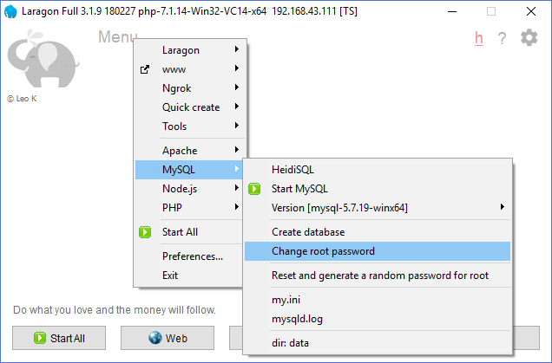
Change DB root password

Slide 9
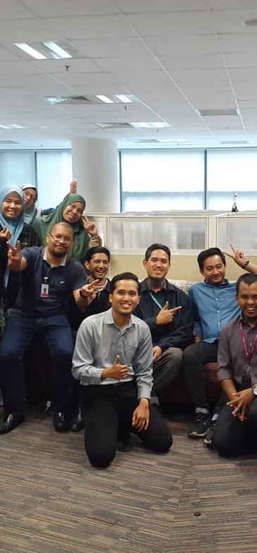

Laravel t02 Tambah laman login & daftar pengguna
fstm.kuis.edu.my/blog/laravel
bit.ly/fstmtube

Slide 10
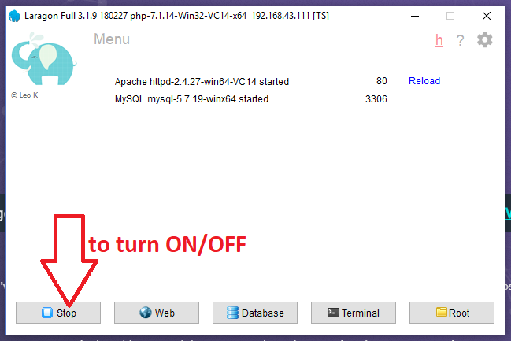
Turn On Laragon
By default Laragon will served port 80 for Apache and port 3306 for DB

Slide 11
Create Project

Slide 12
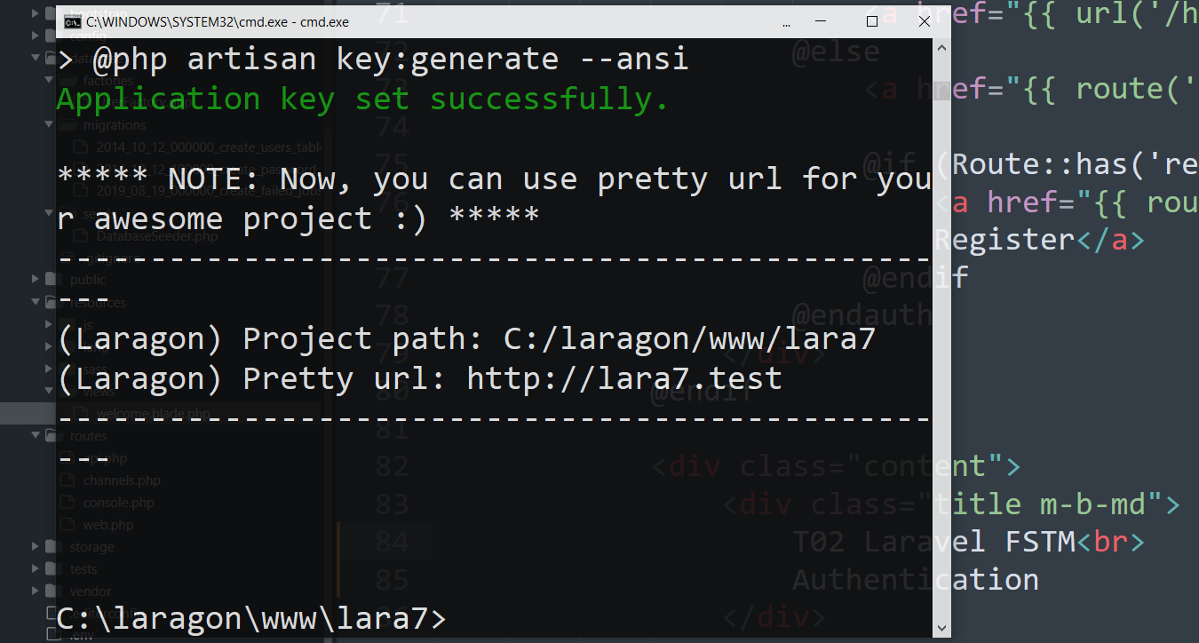
Laravel project with Pretty URL
Test the Pretty url in browser

Slide 13
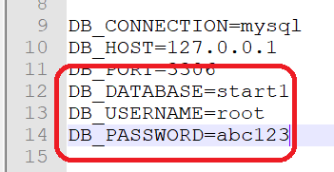
Update DB credentials in .env

Slide 14
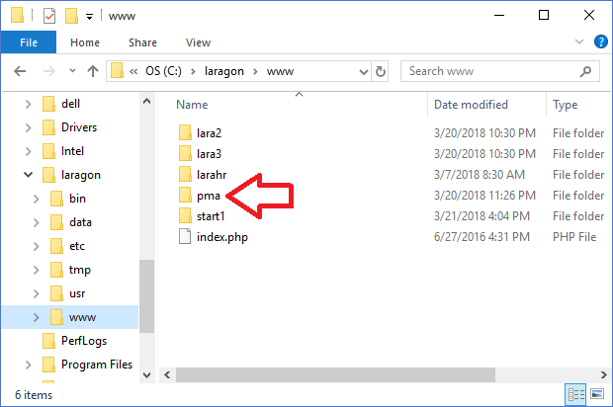
Download and install phpmyadmin.Net
Try access
http://localhost/pma

Slide 15
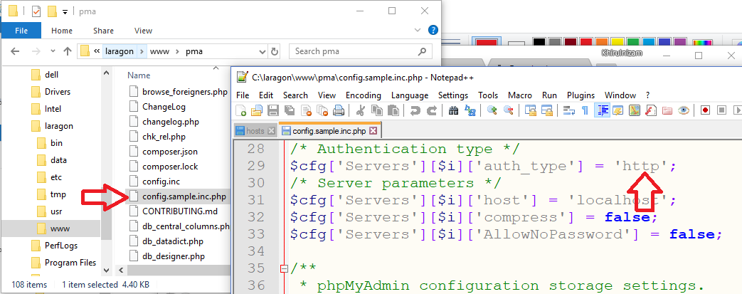
Phpmyadmin config.inc

Slide 16
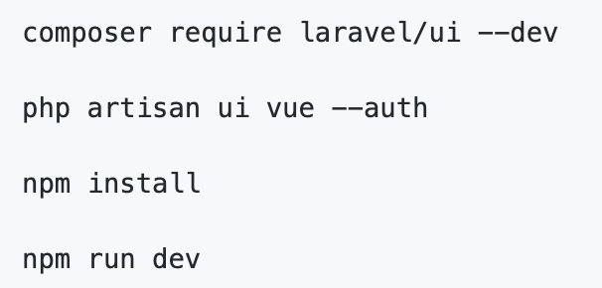
Authentication Module
Laravel makes implementing authentication very simple. In fact, almost everything is configured for you out of the box.

Slide 17
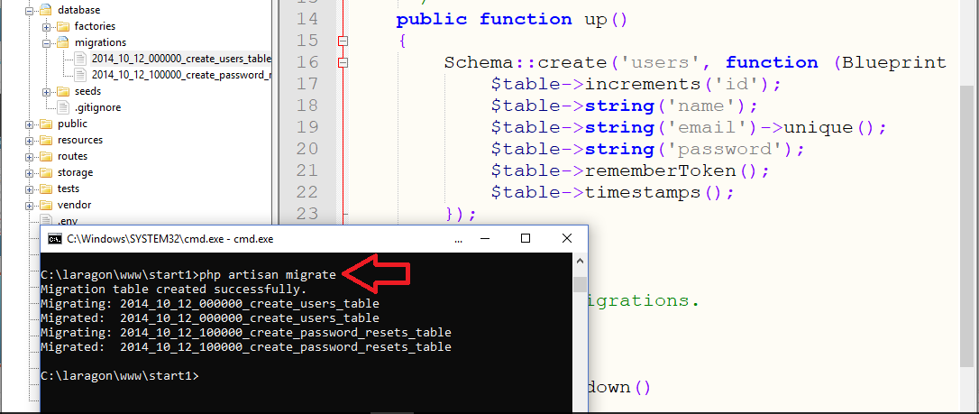
Authentication Module

Slide 18
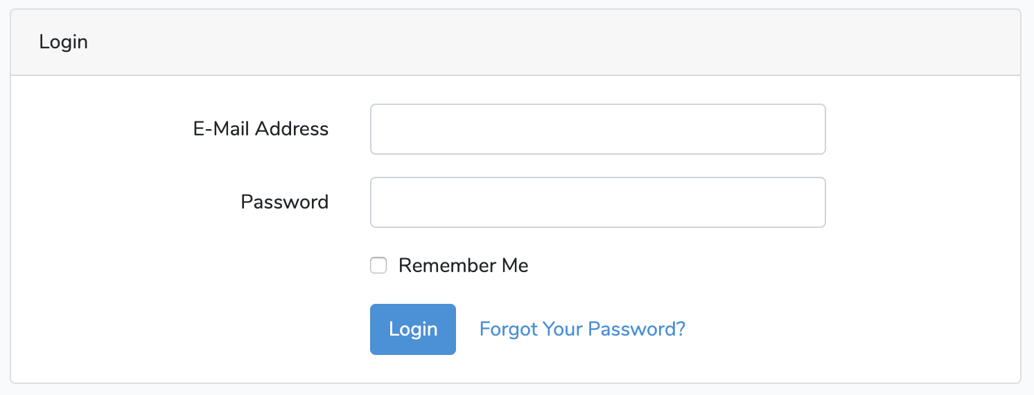
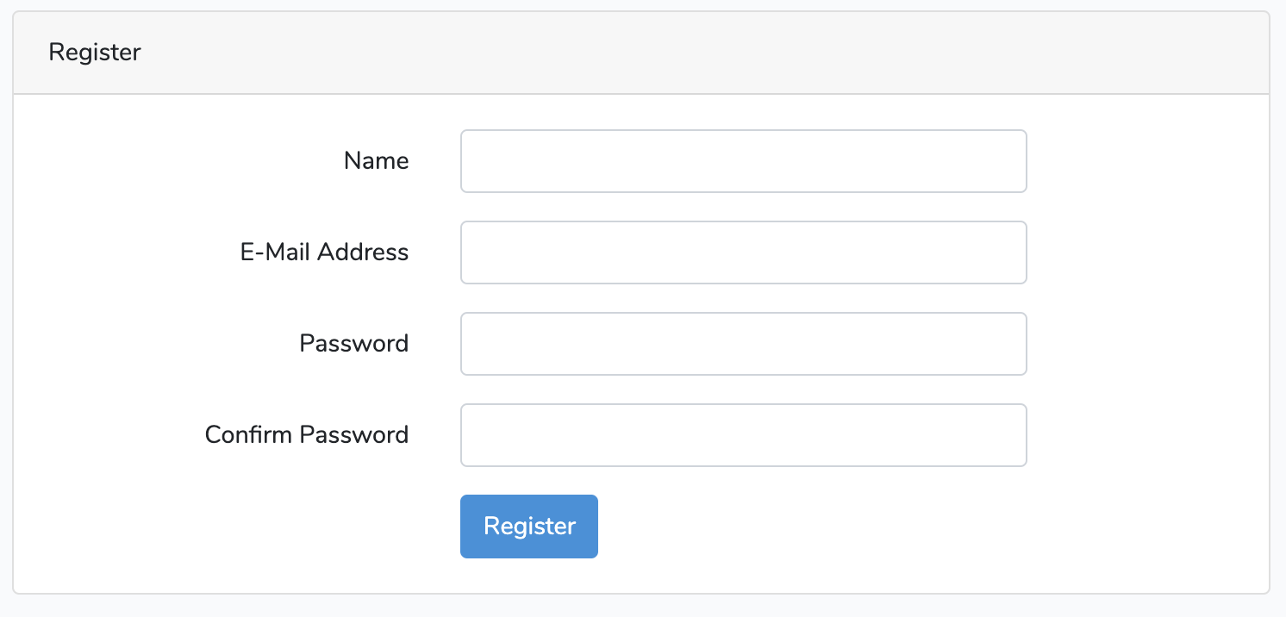
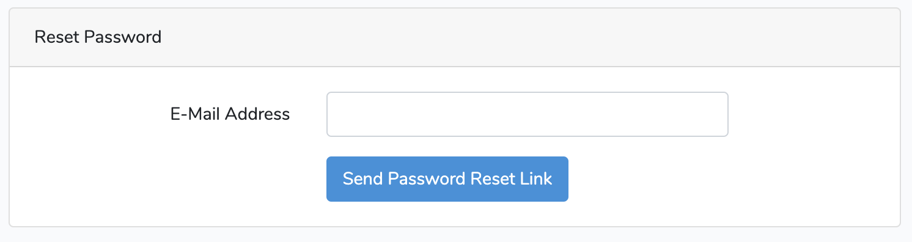

Slide 19
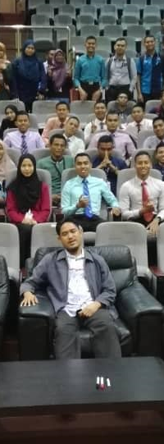
Laravel t03 Pangkalan data – migration, seeder & factory
fstm.kuis.edu.my/blog/laravel
bit.ly/fstmtube

Slide 20
routes/web.php
app/Http/Controllers
app/
resources/views
Notes:
In Slide Show mode, select the arrows to visit links.

Slide 21
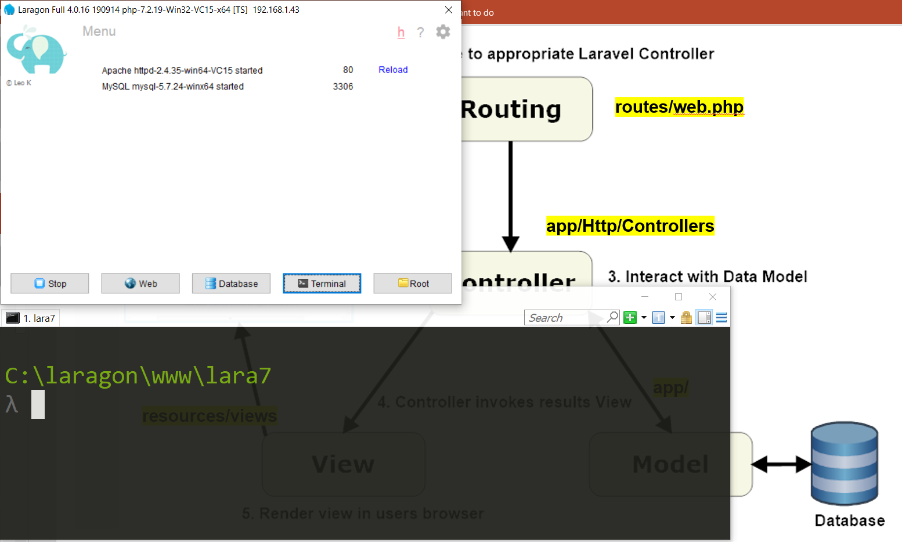

Slide 22
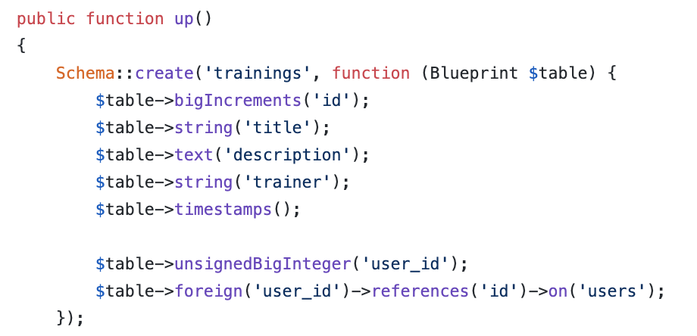
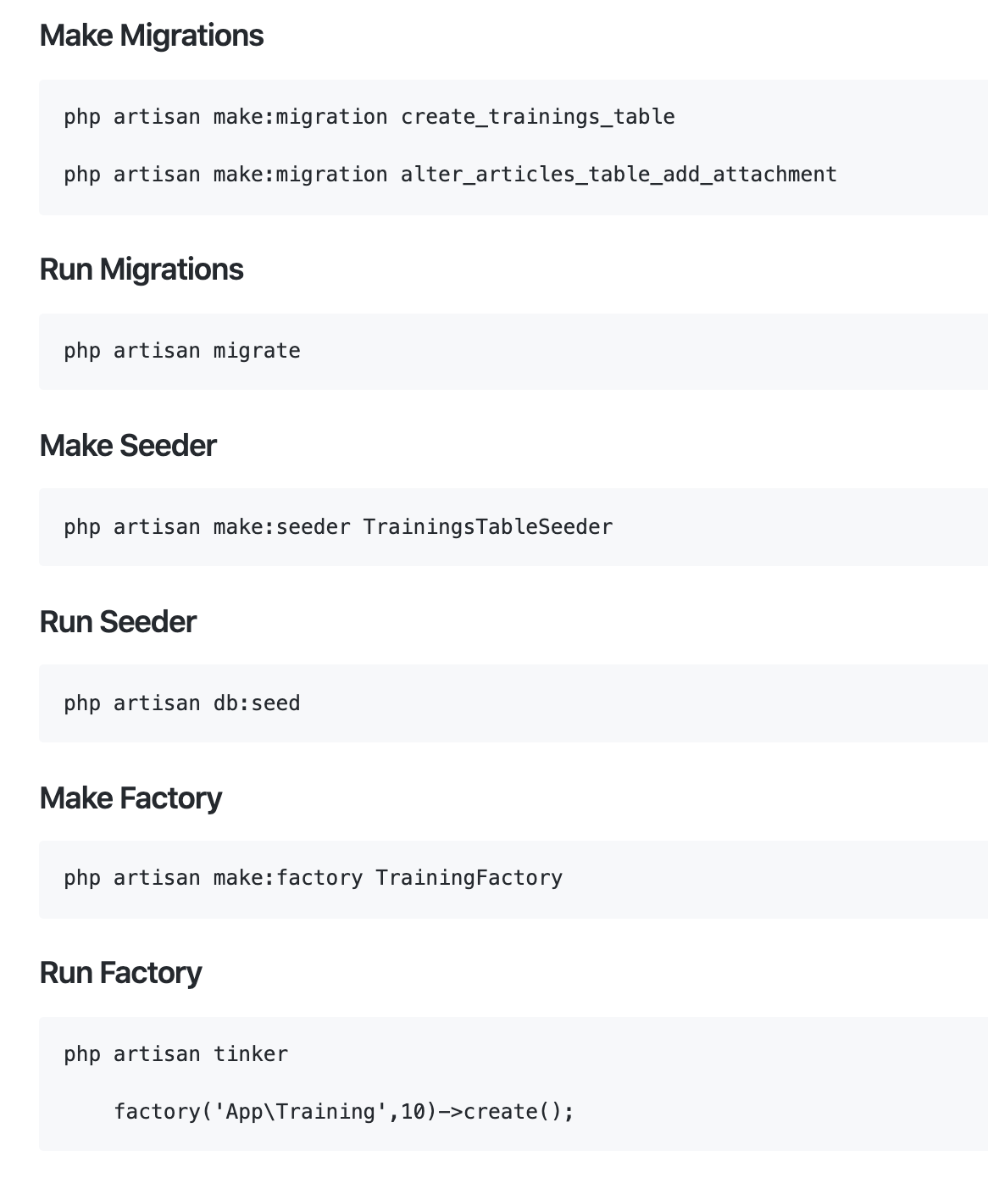
Working with Database
Database Migrations
Migrations are like version control for your database.

Slide 23
php artisan migrate

Slide 24
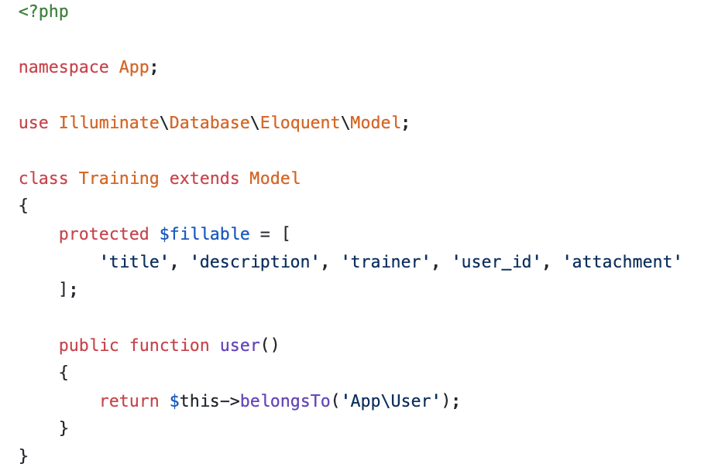
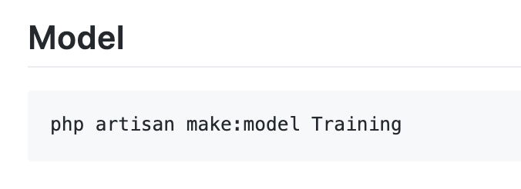
Model
Models typically live in the app directory.
All Eloquent models extend Illuminate\Database\Eloquent\Model class.

Slide 25
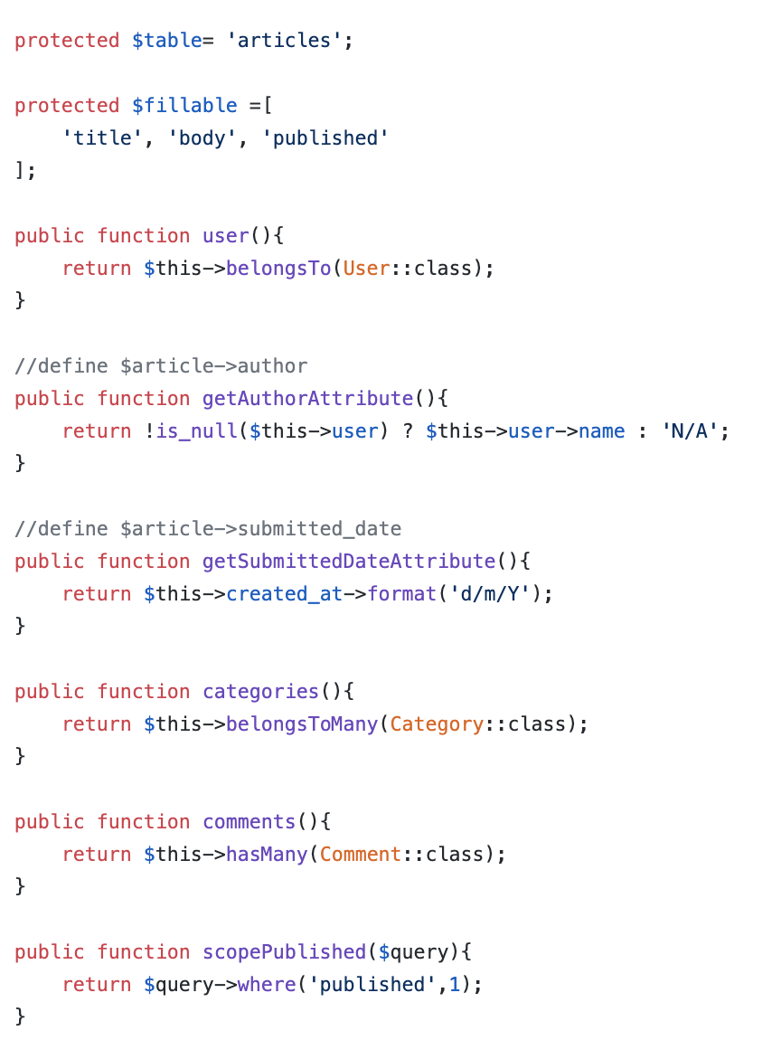
Model
Model used to define fillable attributes.
Model also can be used to define relationship
Model also can be used to to specify custom table.
Model also can be used to define mutator
Model also can be used to define local scope

Slide 26
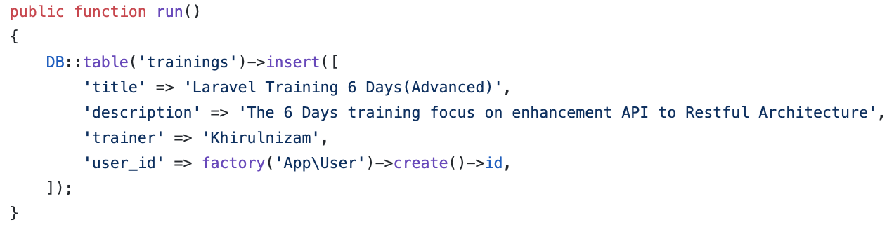
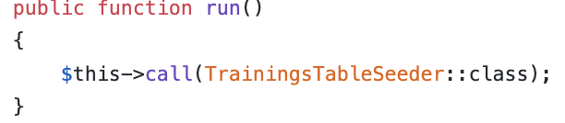
Working with Database
On database/seeds/TrainingsTableSeeder.php
Database Seeds
Laravel includes a simple method of seeding your database with test data using seed classes.
On database/seeds/DatabaseSeeder.php

Slide 27
Working with Database : run seeder

Slide 28
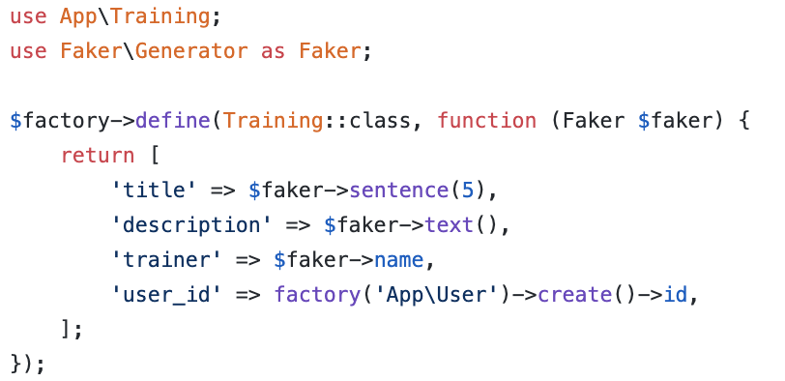
Working with Database
Database Factories
Laravel has a feature called model factories that allows you to build fake data for your models.

Slide 29
How to create and run migrations, seeder and factory?
Here are the example.

Slide 30
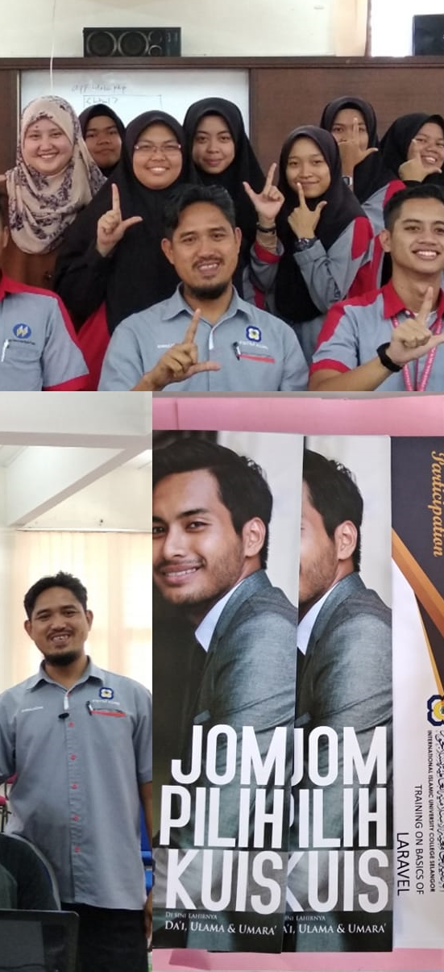
Laravel t04 Views (create form)
fstm.kuis.edu.my/blog/laravel
bit.ly/fstmtube

Slide 31
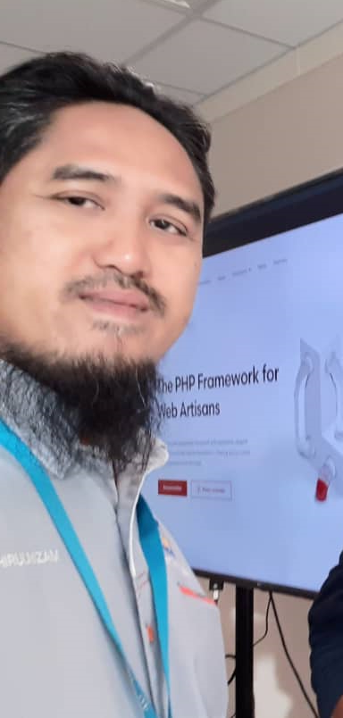
Laravel t05 Views (save new record)
fstm.kuis.edu.my/blog/laravel
bit.ly/fstmtube

Slide 32
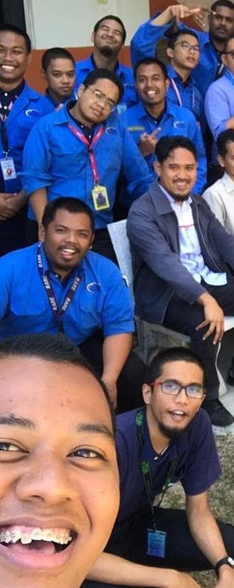
Laravel t06 Views (list records in index)
fstm.kuis.edu.my/blog/laravel
bit.ly/fstmtube

Slide 33
routes/web.php
app/Http/Controllers
app/
resources/views
Notes:
In Slide Show mode, select the arrows to visit links.

Slide 34
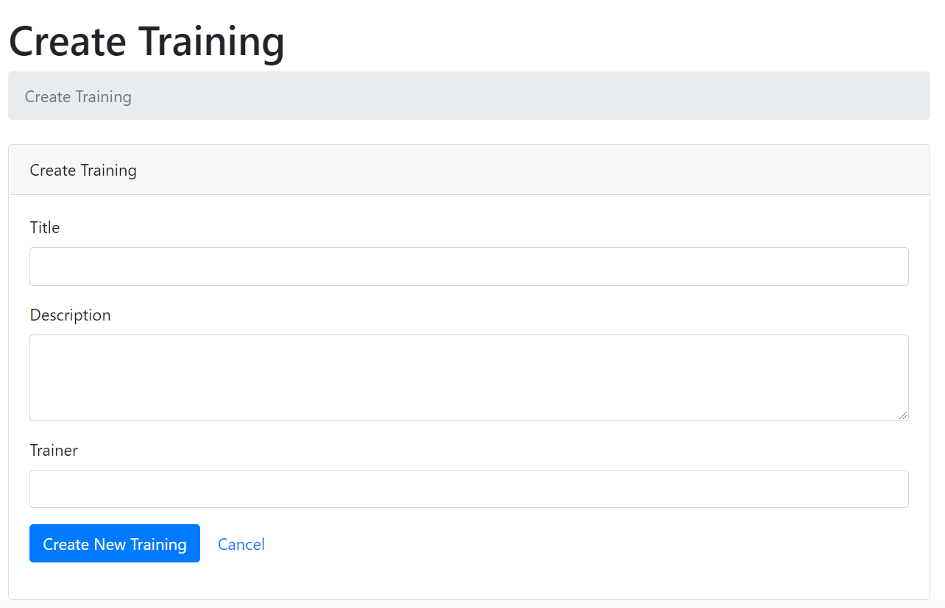
Create new record interface (create.blade.php)

Slide 35
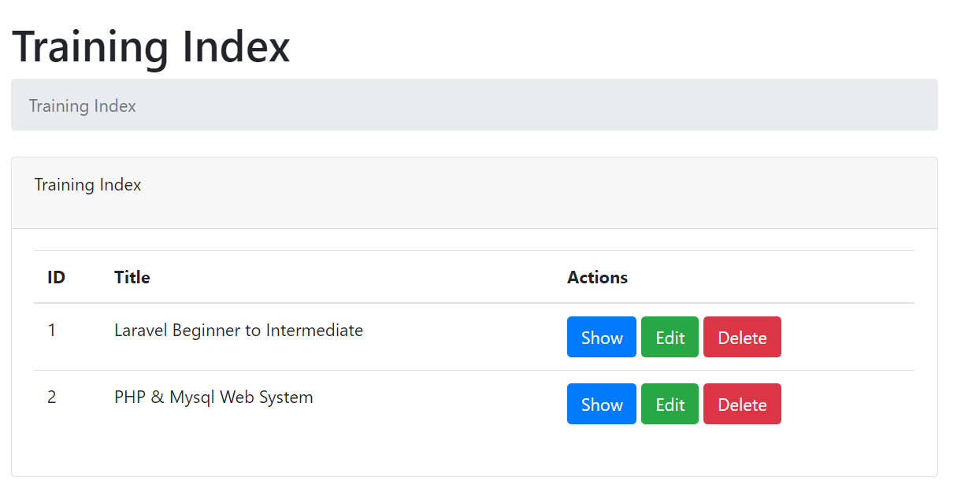
Training index.blade.php

Slide 36
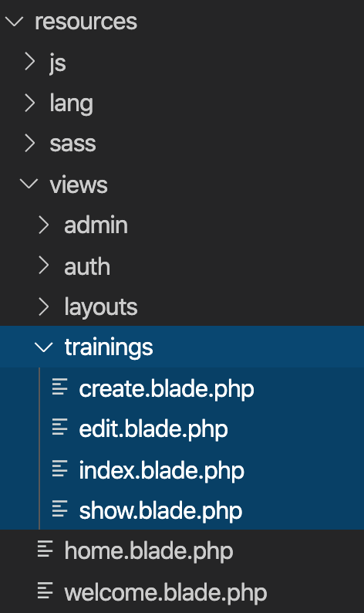
Views
Views contain the HTML served by your application and separate your controller / application logic from your presentation logic.
Views are stored in the resources/views directory
Go to resources/views
Create training folder
Inside training folder, create:
create.blade.php
index.blade.php

Slide 37
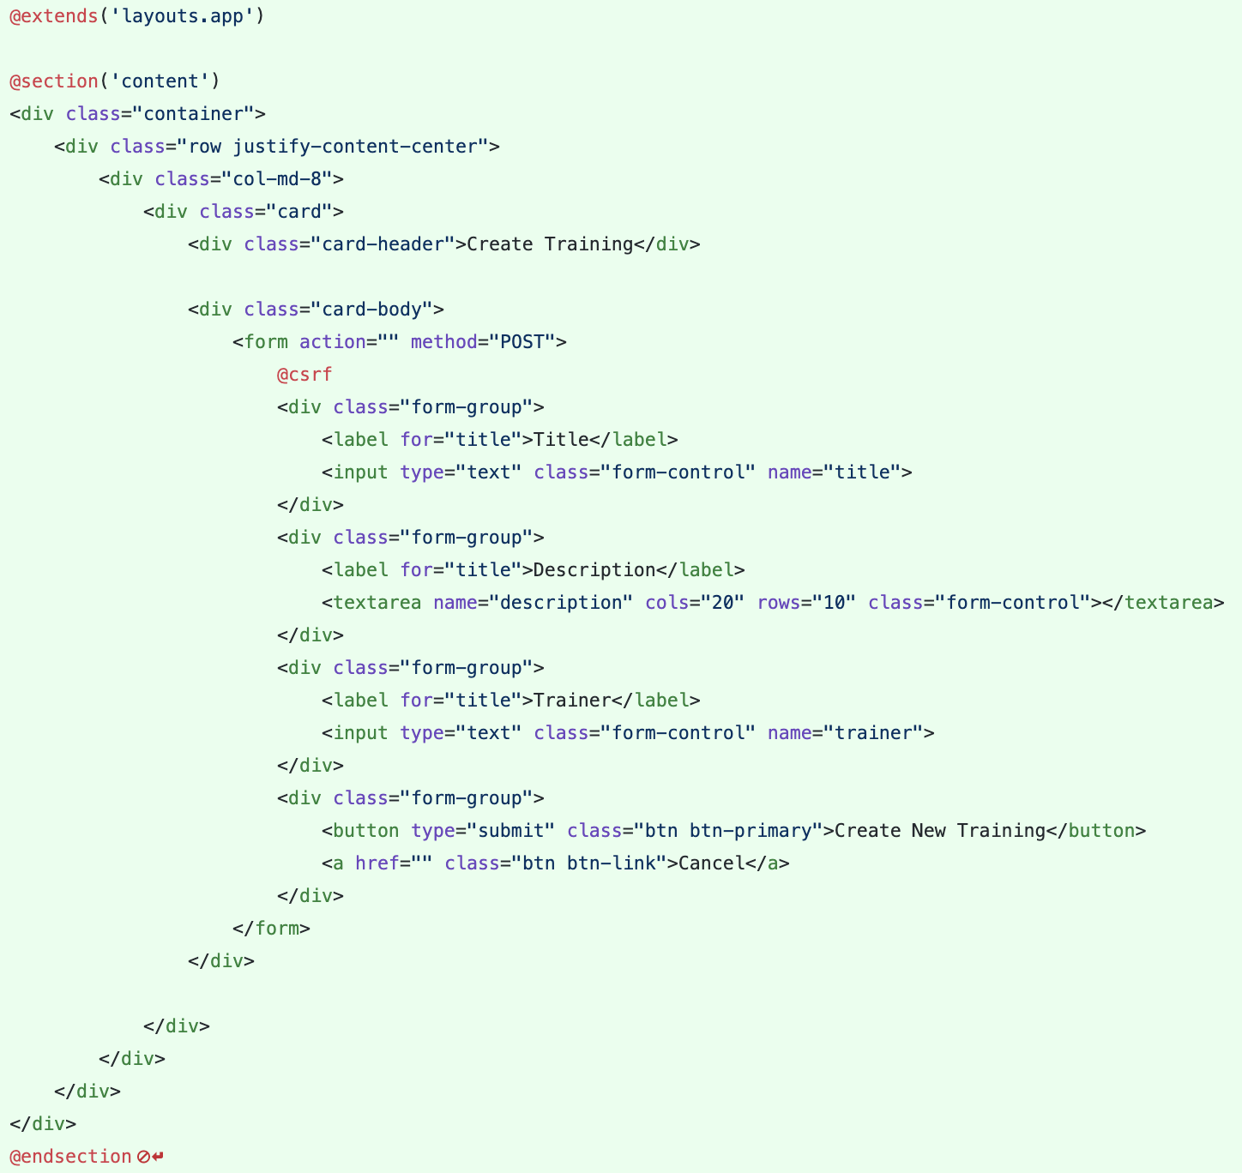
Views – Create View
Views are stored in the resources/views directory
Go to resources/views/trainings/create.blade.php

Slide 38
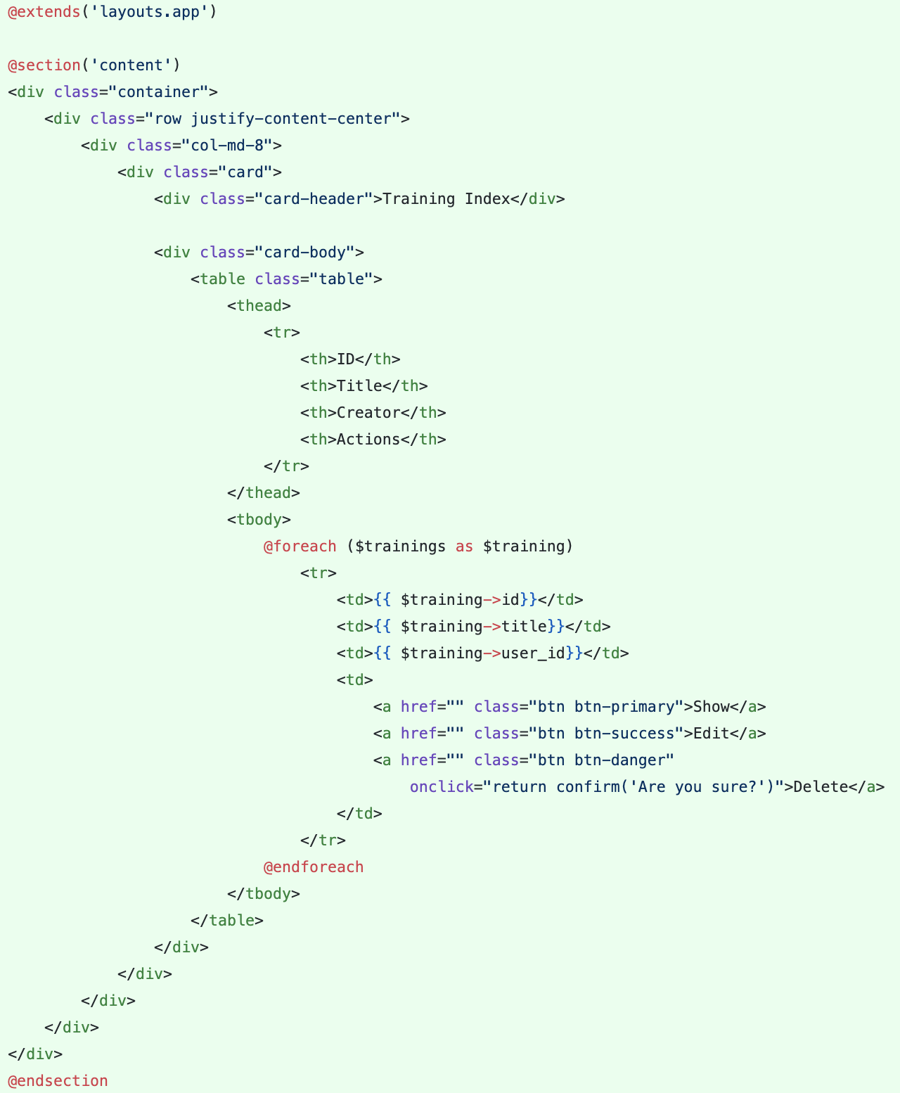
Views – Index View
Views are stored in the resources/views directory
Go to resources/views/trainings/index.blade.php

Slide 39
Laravel t07 Controller
http://fstm.kuis.edu.my/blog/laravel

Slide 40
routes/web.php
app/Http/Controllers
app/
resources/views
Notes:
In Slide Show mode, select the arrows to visit links.

Slide 41
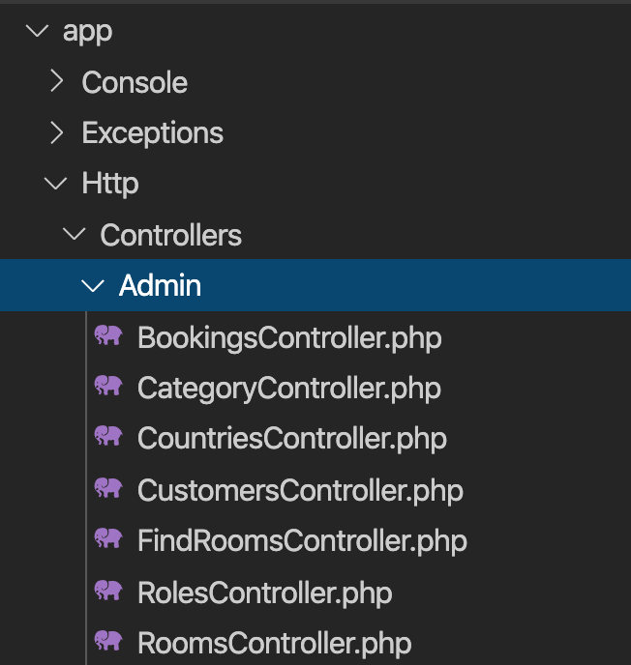
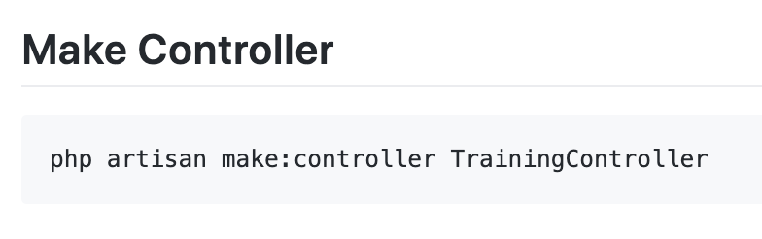
Controller
Instead of defining all of your request handling logic as Closures in route files, you may wish to organize this behavior using Controller classes.
Controllers can group related request handling logic into a single class.
Controllers are stored in the.app/Http/Controllers directory.

Slide 42
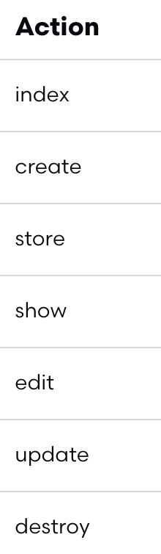
Controller
7 method in controllers

Slide 43
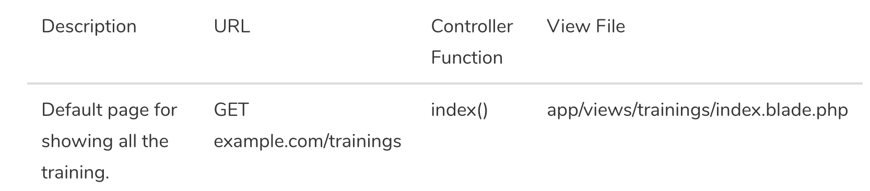
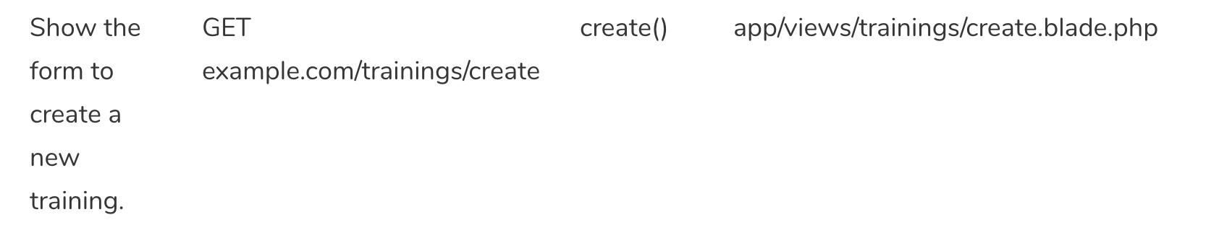
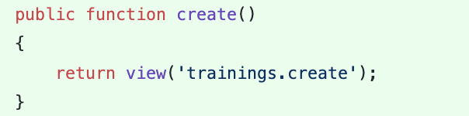
Controller - Create

Slide 44
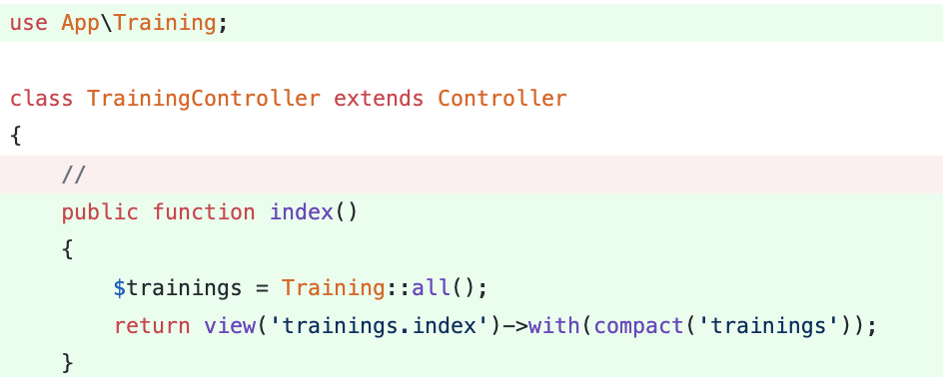
Controller - Index

Slide 45
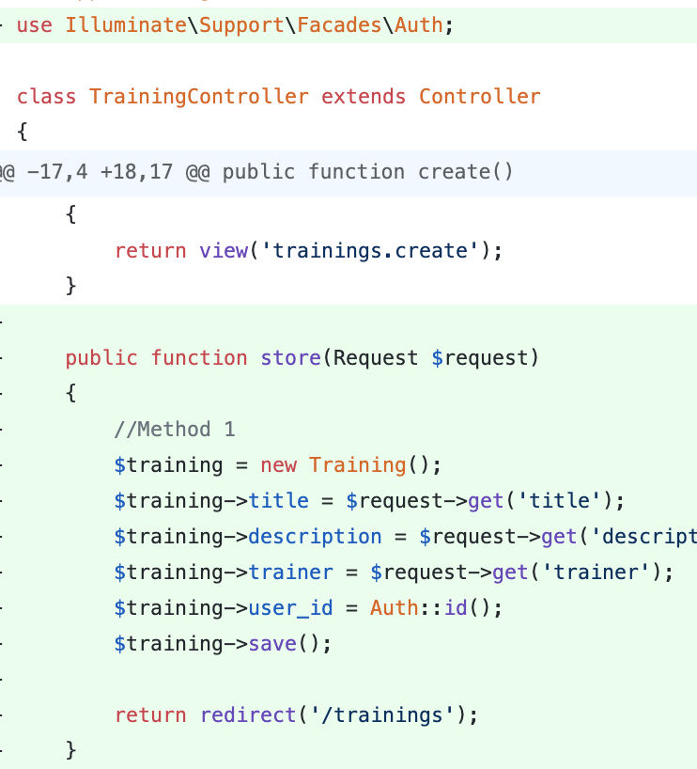
Controller - Store

Slide 46
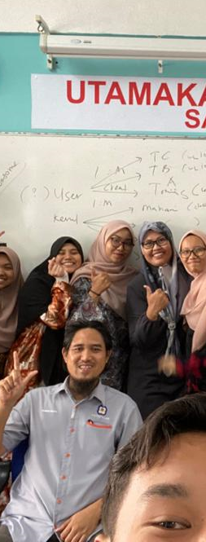
Laravel t09 Routing
fstm.kuis.edu.my/blog/laravel
bit.ly/fstmtube

Slide 47
routes/web.php
app/Http/Controllers
app/
resources/views
Notes:
In Slide Show mode, select the arrows to visit links.

Slide 48
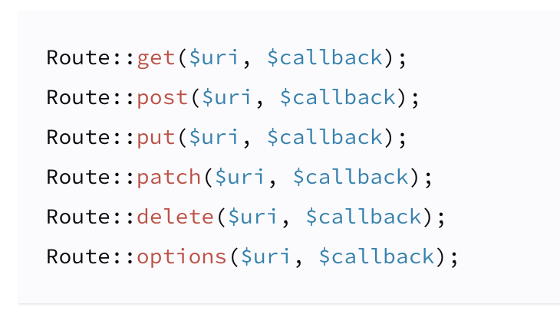
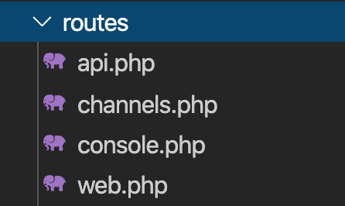
Routing
All Laravel routes are defined in your route files, which are located in the routes directory.
https://laravel.com/docs/6.x/routing.

Slide 49
Simple Routing
All Laravel routes are defined in your route files, which are located in the routes directory.
https://laravel.com/docs/6.x/routing.

Slide 50
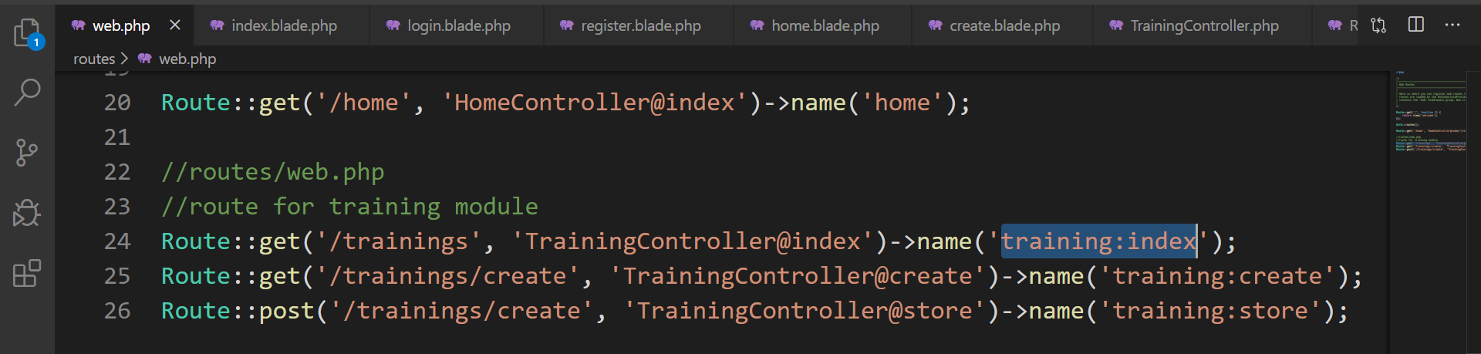
Simple routing ( routes/web.php )
index

Slide 51
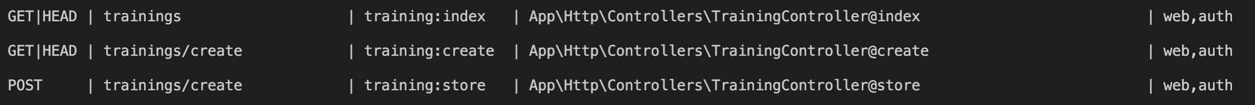
Simple Routing
php artisan route:list
https://laravel.com/docs/6.x/routing.

Slide 52
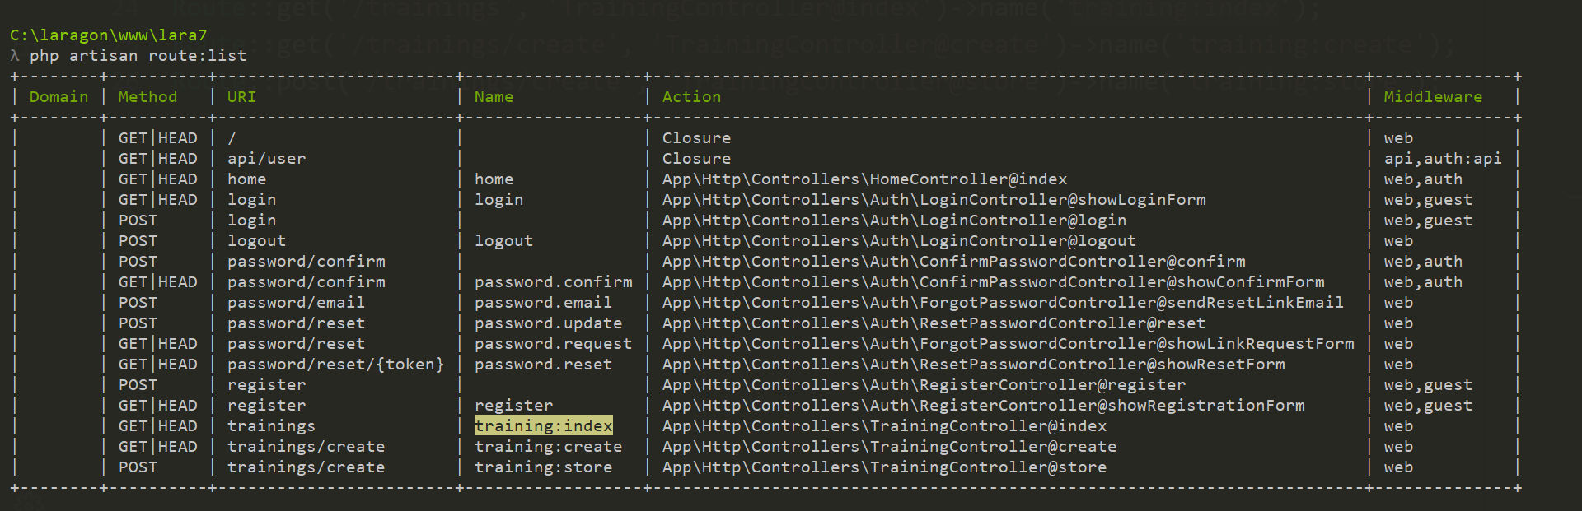
php artisan route:list

Slide 54
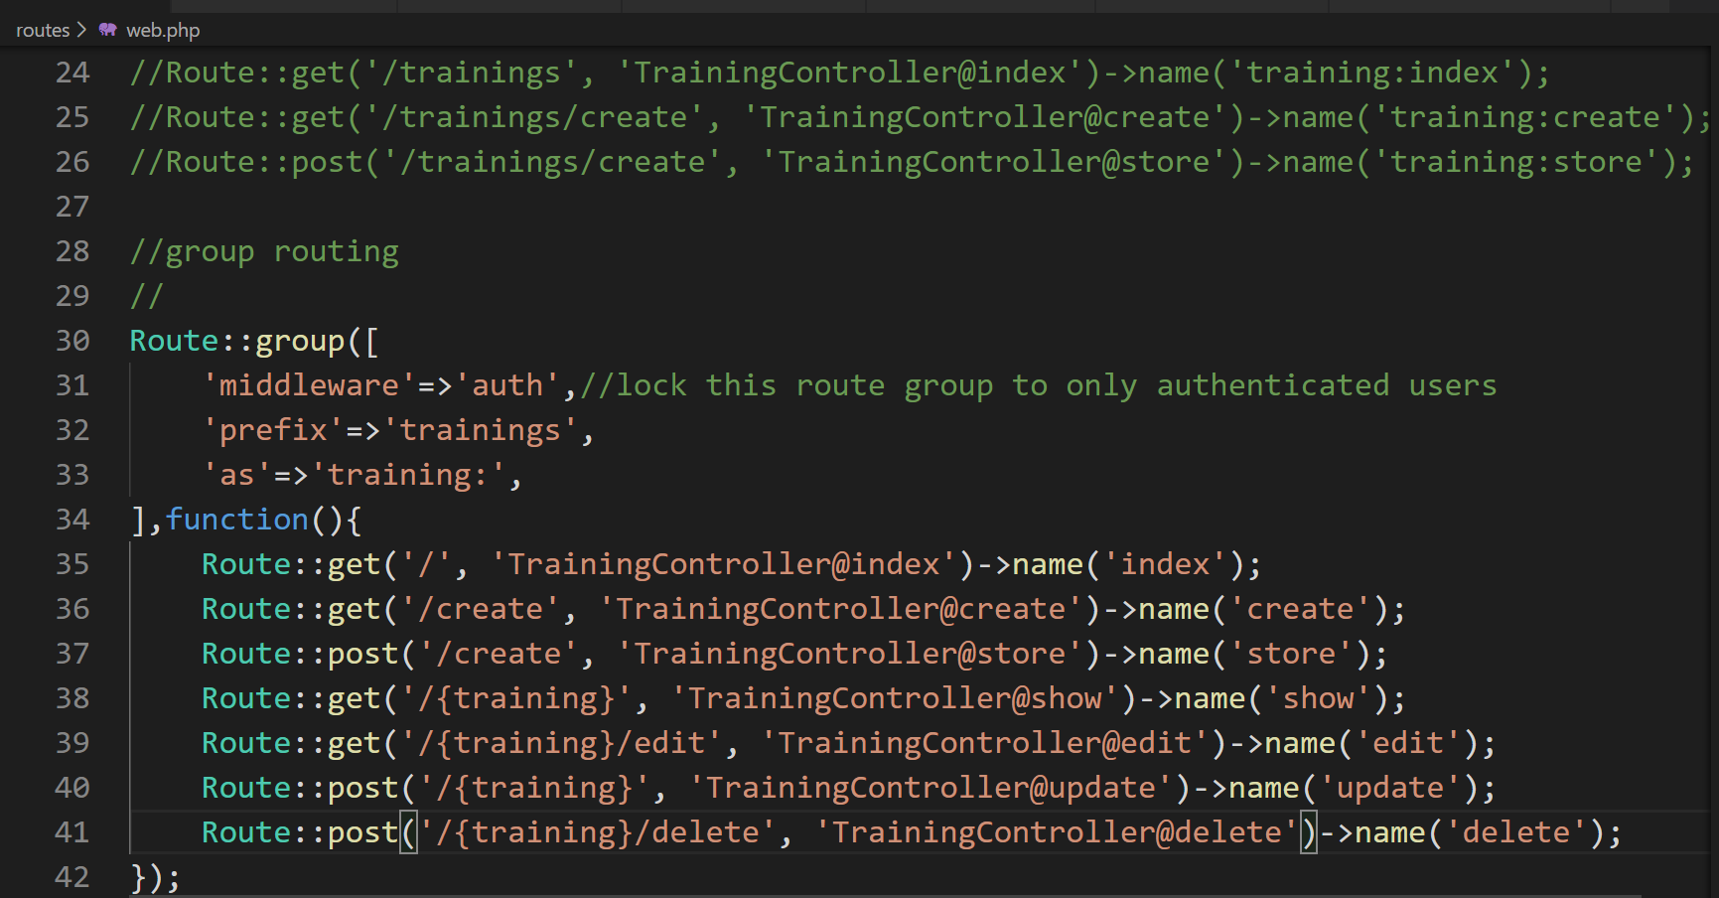
Advanced ROUTING: group & named

Slide 55
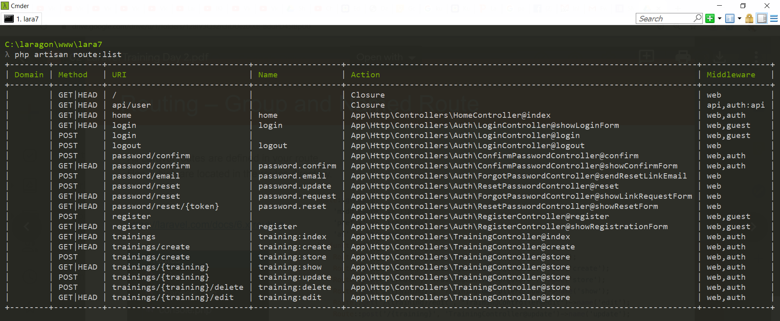
php artisan route:list

Slide 56
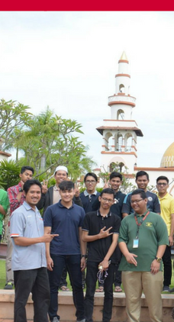
Laravel t07 Search
Tarmizi Sanusi
Khirulnizam Abd Rahman
fstm.kuis.edu.my/blog/laravel
bit.ly/fstmtube

Slide 57
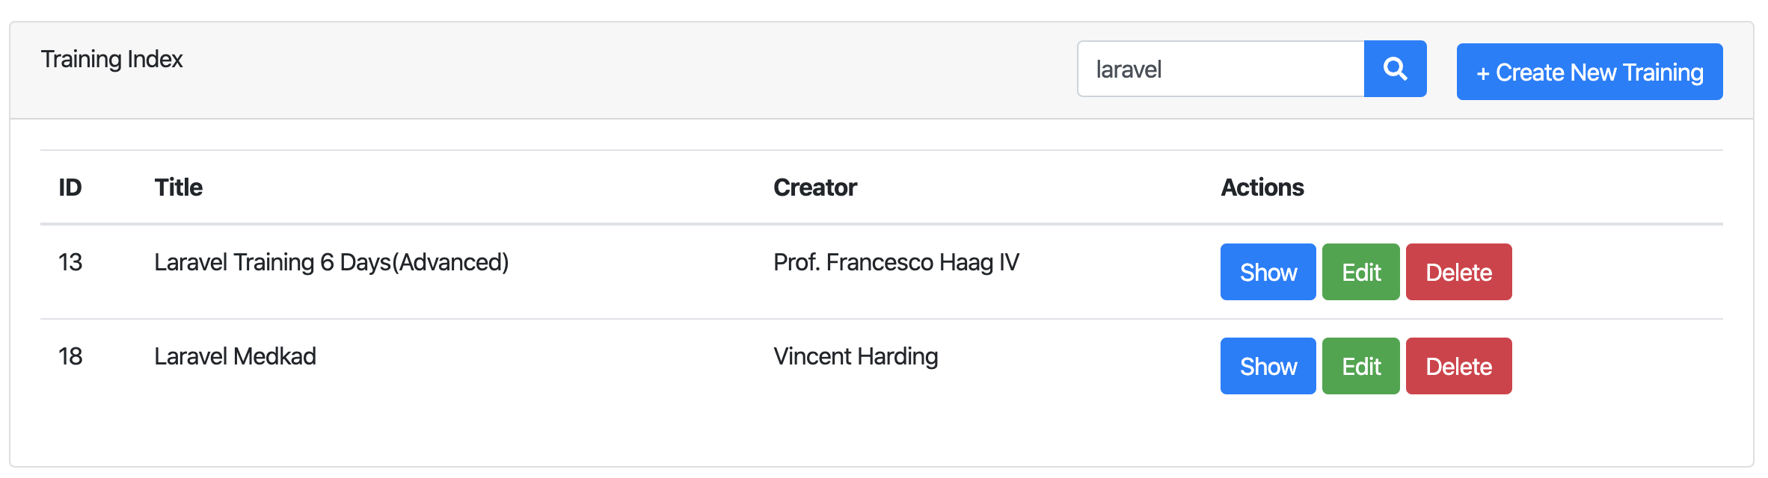
Search
Create form to input keyword
Query the keyword that match with title
https://github.com/samtarmizi/laravel-spr/commit/f5e85dcda0efc4e48186691e3f330f6278dcee52

Slide 58

Search - Form
Using GET method to named route training:index

Slide 59

Simple routing ( routes/web.php )
index

Slide 60
Simple Routing
php artisan route:list
https://laravel.com/docs/6.x/routing.

Slide 61

Search – Index Method
Check if there is keyword, if there is keyword on query string, run query to search column where like title.
If no keyword, the method will return collection rows from trainings table.

Slide 62

Laravel t08 Pagination
Tarmizi Sanusi
Khirulnizam Abd Rahman
fstm.kuis.edu.my/blog/laravel
bit.ly/fstmtube

Slide 63


Slide 64


Search - Pagination
The paginate method automatically takes care of setting the proper limit and offset based on the current page being viewed by the user and append with keywords.
https://github.com/samtarmizi/laravel-spr/commit/6b0d8b3c64bd42c58af97fc49b2c48d983273f1d

Slide 65

TrainingController@index

Slide 66
Hacks
Creating Index - https://github.com/samtarmizi/laravel-spr/commit/1c925853f61da081f0e3ce298e58a4a423b66040
Creating Create - https://github.com/samtarmizi/laravel-spr/commit/7a5b5f3b643bcb8a265af3bb9f4e94e3aef95aa1
Creating Store - https://github.com/samtarmizi/laravel-spr/commit/2513b55c65bc4d27afa5004144ee2c7d41b3cbd7

Slide 67
Laravel t10 npm not found
fstm.kuis.edu.my/blog/laravel
bit.ly/fstmtube

Slide 68


npm not found

Slide 69
Authentication Module
Laravel makes implementing authentication very simple. In fact, almost everything is configured for you out of the box.

Slide 70

Laragon
Includes NODEJS

Slide 71

Terminal in Laragon
Laravel makes implementing authentication very simple. In fact, almost everything is configured for you out of the box.

Slide 72

Locate nodejs in Laragon

Slide 73

Environment variables

Slide 74

Set path to nodejs

Slide 75

NODEJS.ORG

Slide 76

Laravel t11 Middleware enforced Auth
fstm.kuis.edu.my/blog/laravel
bit.ly/fstmtube

Slide 77

Middleware
Middleware provide a convenient mechanism for filtering HTTP requests entering your application.
For example, Laravel includes a middleware that verifies the user of your application is authenticated. If the user is not authenticated, the middleware will redirect the user to the login screen.

Slide 78

Add to dashboard menu

Slide 79

Laravel t12 Test Laravel project from Github repo

Slide 80
NODEJS.ORG

Slide 81

Github.com/khirulnizam/lara7

Slide 82

Git clone

Slide 83

composer & npm install

Slide 84

.env file

Slide 85
php artisan migrate & seed
Inside Laravel project folder
php artisan key:generate
php artisan migrate
php artisan db:seed

Slide 86
Laravel t13 Show records (Paparan semua data dalam rekod) bit.ly/fstmtube

Slide 87

Table with lots of column

Slide 88
Github.com/khirulnizam/lara7
Slides & codes

Slide 89
DISCLAIMER
Codes are for demo purposes. Example showed here are only to validate the proof of concepts. Security aspect the demonstrated examples are beyond the coverage of these video tutorials. You are advised to explore / sought after advanced/security topics of PHP web programming as these tutorials only for beginner level.
Suitable to view in DESKTOP

Slide 90
Views
Views are stored in the resources/views directory
Go to resources/views
Go to trainings folder, create:
show.blade.php
edit.blade.php

Slide 91
Controller
7 method in controllers

Slide 92
routes/web.php
app/Http/Controllers
app/
resources/views
Notes:
In Slide Show mode, select the arrows to visit links.

Slide 93


Controller - Show

Slide 94
Views – Show View
Views are stored in the resources/views directory
Go to resources/views/trainings/show.blade.php

Slide 95

Github.com/khirulnizam/lara7

Slide 96
Github.com/khirulnizam/lara7
Slides & codes

Slide 97


Laravel t14 Font-awesome thru CDN (Pasang icon font-awesome guna CDN)

Slide 98
Github.com/khirulnizam/lara7
Slides & codes

Slide 99

CDN – CONTENT DELIVERY NETWORK
CDN – load library/ framework from public host server
to provide high availability and performance
https://www.bootstrapcdn.com/fontawesome/

Slide 100

FONTAWESOME IN SIMPLE HTML

Slide 101

Import font-awesome from CDN

Slide 102

Tag: <i></i>
<i class="fa fa-file-text"></i>
<p>Used on a button:</p>
<button>
Show <i class="fa fa-file-text"></i>
</button>

Slide 103

Import font-awesome CDN in Laravel layout

Slide 104
https://www.bootstrapcdn.com/fontawesome/

Slide 105

Implement in buttons

Slide 106
Github.com/khirulnizam/lara7
Slides & codes

Slide 107
Laravel t15 Edit/Update (Kemaskini data dalam rekod) bit.ly/fstmtubelaravel

Slide 108

UPDATE RECORD PROCESS
Index (choose )
id
Edit (form)
id
Update (save)

Slide 109
DISCLAIMER
Codes are for demo purposes. Example showed here are only to validate the proof of concepts. Security aspect the demonstrated examples are beyond the coverage of these video tutorials. You are advised to explore / sought after advanced/security topics of PHP web programming as these tutorials only for beginner level.
Suitable to view in DESKTOP

Slide 110
Github.com/khirulnizam/lara7
Slides & codes
T12 Tutorial clone/download github repo

Slide 111


Controller - Edit

Slide 112
Views – Edit View
Views are stored in the resources/views directory
Go to
resources/views/trainings/edit.blade.php

Slide 113


Slide 114


Controller - Update

Slide 115


Output screen

Slide 116
Laravel t16 Delete records (Padam rekod) bit.ly/fstmtubelaravel

Slide 117
DISCLAIMER
Codes are for demo purposes. Example showed here are only to validate the proof of concepts. Security aspect the demonstrated examples are beyond the coverage of these video tutorials. You are advised to explore / sought after advanced/security topics of PHP web programming as these tutorials only for beginner level.
Suitable to view in DESKTOP

Slide 118
Github.com/khirulnizam/lara7
Slides & codes
T12 Tutorial clone/download github repo

Slide 119

Overview

Slide 120

Delete button inside FORM

Slide 121

Routing – Group and Named Route
All Laravel routes are defined in your route files, which are located in the routes directory.
https://laravel.com/docs/7.x/routing.

Slide 122

Routing – Group and Named Route
php artisan route:list
https://laravel.com/docs/7.x/routing.

Slide 123


Controller – Destroy/Delete

Slide 124
Laravel t17 @csrf (Built-in security token for post method) bit.ly/fstmtubelaravel

Slide 125
DISCLAIMER
Codes are for demo purposes. Example showed here are only to validate the proof of concepts. Security aspect the demonstrated examples are beyond the coverage of these video tutorials. You are advised to explore / sought after advanced/security topics of PHP web programming as these tutorials only for beginner level.
Suitable to view in DESKTOP

Slide 126
Github.com/khirulnizam/lara7
Slides & codes
T12 Tutorial clone/download github repo

Slide 127

What is CSRF?
OWASP.org
Cross-Site Request Forgery
- is an attack that forces an end user to execute unwanted actions on a web application in which they're currently authenticated.

Slide 128


Implementation in Laravel blade

Slide 129



Location of csrf app_key
Use to hash security token

Slide 130
Laravel t18 Apply Bootstrap Layout (Pasang layout Bootstrap baru) bit.ly/fstmtubelaravel

Slide 131

Output overview

Slide 132
DISCLAIMER
Codes are for demo purposes. Example showed here are only to validate the proof of concepts. Security aspect the demonstrated examples are beyond the coverage of these video tutorials. You are advised to explore / sought after advanced/security topics of PHP web programming as these tutorials only for beginner level.
Suitable to view in DESKTOP

Slide 133
Github.com/khirulnizam/lara7
Slides & codes
T12 Tutorial clone/download github repo

Slide 134

Theme from https://startbootstrap.com/themes/landing-page/

Slide 135

Asset/resources for template

Slide 136

Blade asset( ) function – apply on both css & js

Slide 137

@yield( )

Slide 138


@yield( )

Slide 139
Output overview

Slide 140

landingpage.blade.php

Slide 141

route/web.php

Slide 142
Github.com/khirulnizam/lara7
Slides & codes
T12 Tutorial clone/download github repo

Slide 143
Laravel t19 Apply Bootstrap on Admin Dashboard (Pasang layout Bootstrap baru pada Panel Admin) bit.ly/fstmtubelaravel

Slide 144

Output overview

Slide 145
DISCLAIMER
Codes are for demo purposes. Example showed here are only to validate the proof of concepts. Security aspect the demonstrated examples are beyond the coverage of these video tutorials. You are advised to explore / sought after advanced/security topics of PHP web programming as these tutorials only for beginner level.
Suitable to view in DESKTOP

Slide 146
Github.com/khirulnizam/lara7
Slides & codes
T12 Tutorial clone/download github repo

Slide 147

Theme from https://startbootstrap.com/themes/sb-admin-2/

Slide 148

Asset/resources for template

Slide 149

First time display the new template

Slide 150

Blade asset( ) function – apply on both css & js

Slide 151

@yield( )

Slide 152


@yield( )
@yield( )

Slide 153
Output overview

Slide 154

index.blade.php

Slide 155
Github.com/khirulnizam/lara7
Slides & codes
T12 Tutorial clone/download github repo

Slide 156
Laravel t20
Muat naik fail gambar

Slide 157


Output Overview
Show uploaded image
Upload image

Slide 158
DISCLAIMER
Codes are for demo purposes. Example showed here are only to validate the proof of concepts. Security aspect the demonstrated examples are beyond the coverage of these video tutorials. You are advised to explore / sought after advanced/security topics of PHP web programming as these tutorials only for beginner level.
Suitable to view in DESKTOP

Slide 159
Github.com/khirulnizam/lara7
Slides & codes
T12 Tutorial clone/download github repo

Slide 160

Add column to table trainings
Field to hold image’s filename

Slide 161

Additional field to table trainings

Slide 162

function up() – additional migration file

Slide 163

php artisan migrate

Slide 164
create.blade.php – to select and upload image
Upload image

Slide 165

Add enctype in create.blade.php

Slide 166

Add input type=“file” in create.blade.php

Slide 167

app/Training.php - Add fillable for the fields

Slide 168

Validate uploaded file type

Slide 169

TrainingController@store – validate file type

Slide 170

TrainingController@store – continued…

Slide 171


Storage not found

Slide 172

Configuring Filesystem for Storage config/filesystems.php

Slide 173

File Storage
Create Symbolic Link
The public disk is intended for files that are going to be publicly accessible.
By default, the public disk uses the local driver and stores these files in storage/app/public.
To make them accessible from the web, you should create a symbolic link from public/storage to storage/app/public.

Slide 174

Virtual link of public file storage

Slide 175

Physical link of public file storage
The actual physical location of the file storage
To make them accessible from the web, you should create a symbolic link from public/storage to storage/app/public.

Slide 176

create.blade.php - Display validation errors

Slide 177
Github.com/khirulnizam/lara7
Slides & codes
T12 Tutorial clone/download github repo

Slide 178
Laravel t19 Table relationship (Jadual dengan perhubungan 1-Many)

Slide 179
Laravel t20 Insert record with drop down data option (Masukkan data baharu dengan jadual berhubungan)

Slide 180
Laravel t21 Upload record with file (Muat naik sebarang fail)

